Slide 1
14.7 Cross-Validation Techniques for Recursively Defined Trees

Slide 2
Early stopping

Slide 3
We can easily use cross-validation to dictate the proper maximum depth of a tree by growing a tree of large depth, measuring validation error at each depth of the tree, and (after the fact) determine which depth produced minimal validation error.
Alternatively, we can stop the growth early when we are confident that (something approximating) minimum validation error has been achieved.
This approach, while used in practice, translates to a relatively coarse model search since the capacity of a tree grows exponentially from one depth to the next.

Slide 4
Practical considerations are often used to halt the leaf splitting, including halting splitting:
if a leaf contains a singleton data point or a pre-decided (small) number of points
if all data points belong to the same class (in the case of classification)
if all data points have approximately the same output value (in the case of regression)

Slide 5
To create a finer-resolution cross-validation search we can add validation-error-focused criteria to halt the growth of individual leaves as well.
The simplest such criterion is to check whether or not splitting a leaf will result in lowering validation error (or lowering training error past a predetermined threshold): if yes, the leaf is split, otherwise growth of the leaf is halted.
This approach to cross-validation is unique in that validation error will always monotonically decrease as the maximum depth of a tree is increased, but can result in underfitting models due to leaves halting growth prematurely.

Slide 6
Below we show an example of cross-validating the maximum depth of a tree in the range of 1 to 7 for a simple regression dataset:
training data/error: blue
validation data/error: yellow

Slide 7
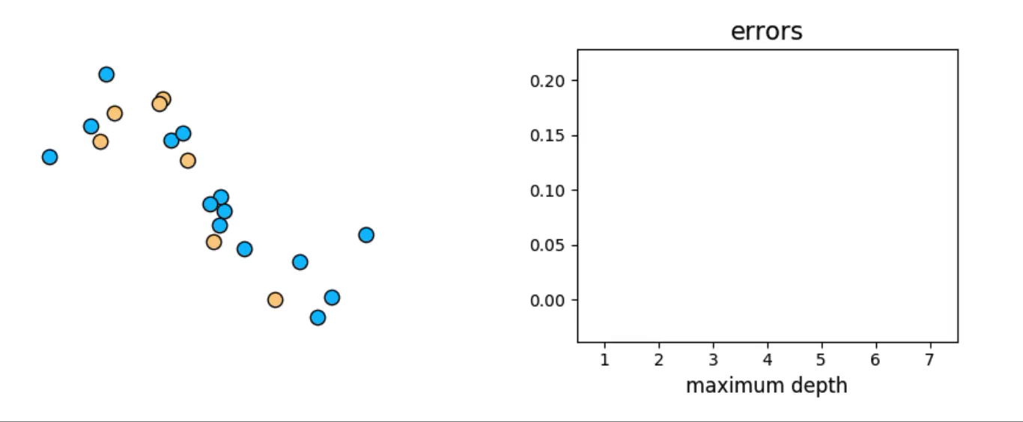

Slide 8
Pruning

Slide 9
In contrast to beginning with a low-capacity (shallow) tree and growing it via early stopping, we can instead begin by fitting a high-capacity (deep) tree and remove leaves that do not improve validation error, until a minimum-validation tree structure remains.
This technique is called pruning because it entails examining an initially overly complicated tree and cutting off its leaves.
While early stopping is often more computationally efficient than pruning, the latter provides a finer-resolution model search in determining the tree structure with minimal validation error, since tree/leaf growth is unhindered and is only cut back after the fact.

